Slide 1
What AI and Cybersecurity Can Learn from the Immune System
From biological principles to SLIPS code
Sebastian Garcia

Slide 2
What AI and Cybersecurity Can Learn from the Immune System
From biological principles to SLIPS code
General-audience seminar for AI and IT people
30 minutes
Goal: extract reusable engineering principles, not teach immunology

Slide 3

Why this topic should matter outside cybersecurity
Many AI systems must act under uncertainty, with noisy and incomplete evidence
Many operational systems must avoid two failures at once:
  miss a real threat
  overreact and damage normal operations
Biology has been solving this tradeoff for a very long time

Slide 4
Nature-inspired research: useful, but easy to do badly
Bad version: copy a biological term and attach it to one algorithm
Better version: ask what control problem biology is solving
Best version: transfer the principle, then redesign it for engineering constraints
The claim of this talk
The immune system is interesting as an architecture for decision-making, coordination, and regulation.

Slide 5
The engineering problem in network detection
Networks are noisy, distributed, and only partially observable
Signals are weak when seen in isolation
Attackers adapt, hide, and blend with benign behavior
False positives are expensive for operators
One alert is rarely enough to justify a strong action

Slide 6
Why current cyber detection often disappoints
Too much focus on isolated detectors
Too little context shared across components
Novelty is often confused with danger
Escalation is not proportional
Shutdown and rollback are usually an afterthought
Result
Alert fatigue, brittle automation, and defenses that can become disruptive themselves.

Slide 7
The immune system is not one detector
It is a distributed, regulated decision system
It combines local sensing with global coordination
It uses multiple activation signals before strong response
It adapts response strength to context
It remembers what worked before
It actively turns responses off

Slide 8
Five principles worth stealing
Distributed sensing
Context propagation
Multi-signal activation
Adaptive aggressiveness and regulated shutdown
Memory and guided generation of new detectors
These are useful in AI too
They apply to agent systems, retrieval systems, automated response, and any pipeline that must act safely under uncertainty.

Slide 9
Principle 1: Distributed sensing
In biology, no single cell sees the whole organism
Robustness comes from many partial observers
Local detection is cheap and continuous
Strong action depends on coordination
Transferable idea
Design systems as networks of specialized observers, not one perfect classifier.

Slide 10
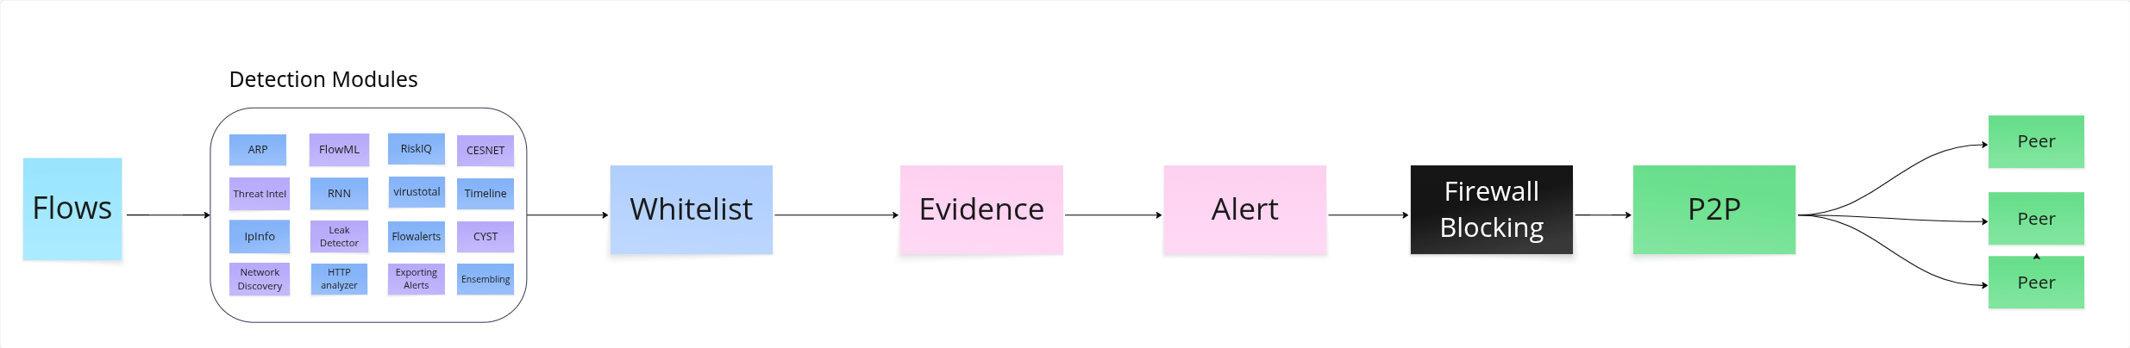
Principle 2: Context propagation
A signal alone is weak
What matters is where it happened, when, how often, and with what supporting evidence
The immune system moves context through antigen presentation and signaling
Transferable idea
Move summaries and evidence through the system, not just raw alerts.

Slide 11
Principle 3: Multi-signal activation
Recognition alone is not enough in biology
Strong action requires corroboration
This is how the immune system reduces false positives
Transferable idea
Use gated decisions:
detector hit
evidence of actual damage or risk
confidence from independent sources

Slide 12
Principle 4: Adaptive aggressiveness and shutdown
Not every anomaly deserves the same response
Good systems scale response with risk
Good systems also know when to stop
Transferable idea
Prefer progressive actions:
observe
slow down
isolate
block
And make rollback a first-class feature.

Slide 13
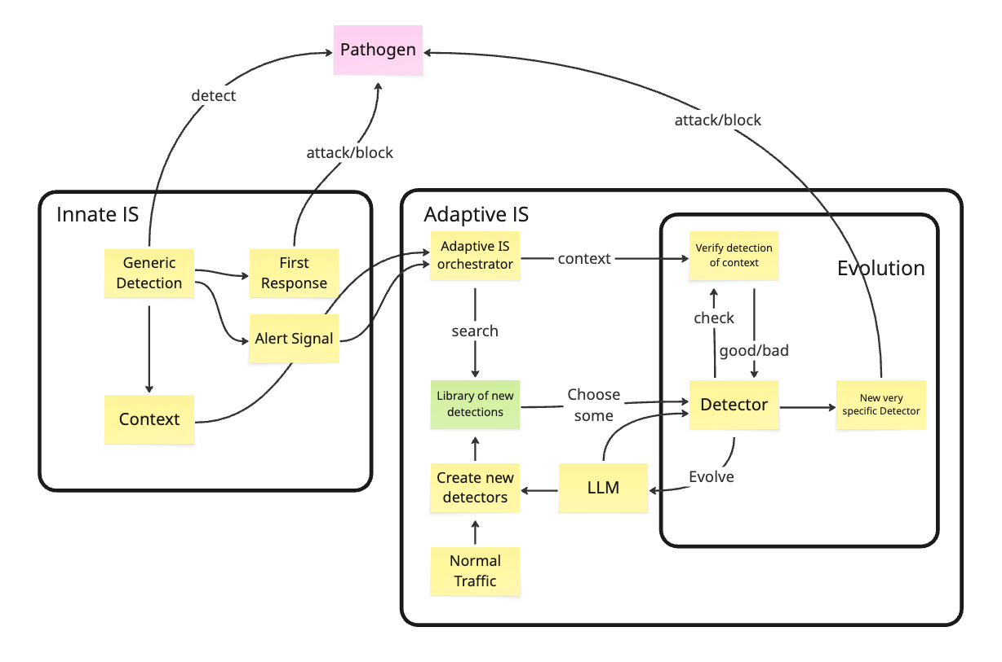
Principle 5: Memory and detector generation
Biology stores useful experience
It also keeps generating new detectors and filtering bad ones
That matters because future threats are not fully known in advance
Transferable idea
A useful system needs both:
persistent memory of confirmed patterns
controlled generation of candidate detectors

Slide 14
Where cybersecurity got immunity wrong
Earlier artificial immune systems often copied one mechanism at a time
Many reduced the idea to anomaly detection plus biological naming
They borrowed metaphors, but not the architecture
The deeper mistake
They asked “which immune trick can detect attacks?” instead of “how does immunity coordinate uncertain evidence safely?”

Slide 15
A better cyber-immune interpretation
Use immunity as a design reference for:
distributed coordination
context-aware evidence
multi-signal gating
proportional response
memory
termination
Important caveat
Computers are not organisms. Principles transfer. Literal biological copying usually does not.

Slide 16
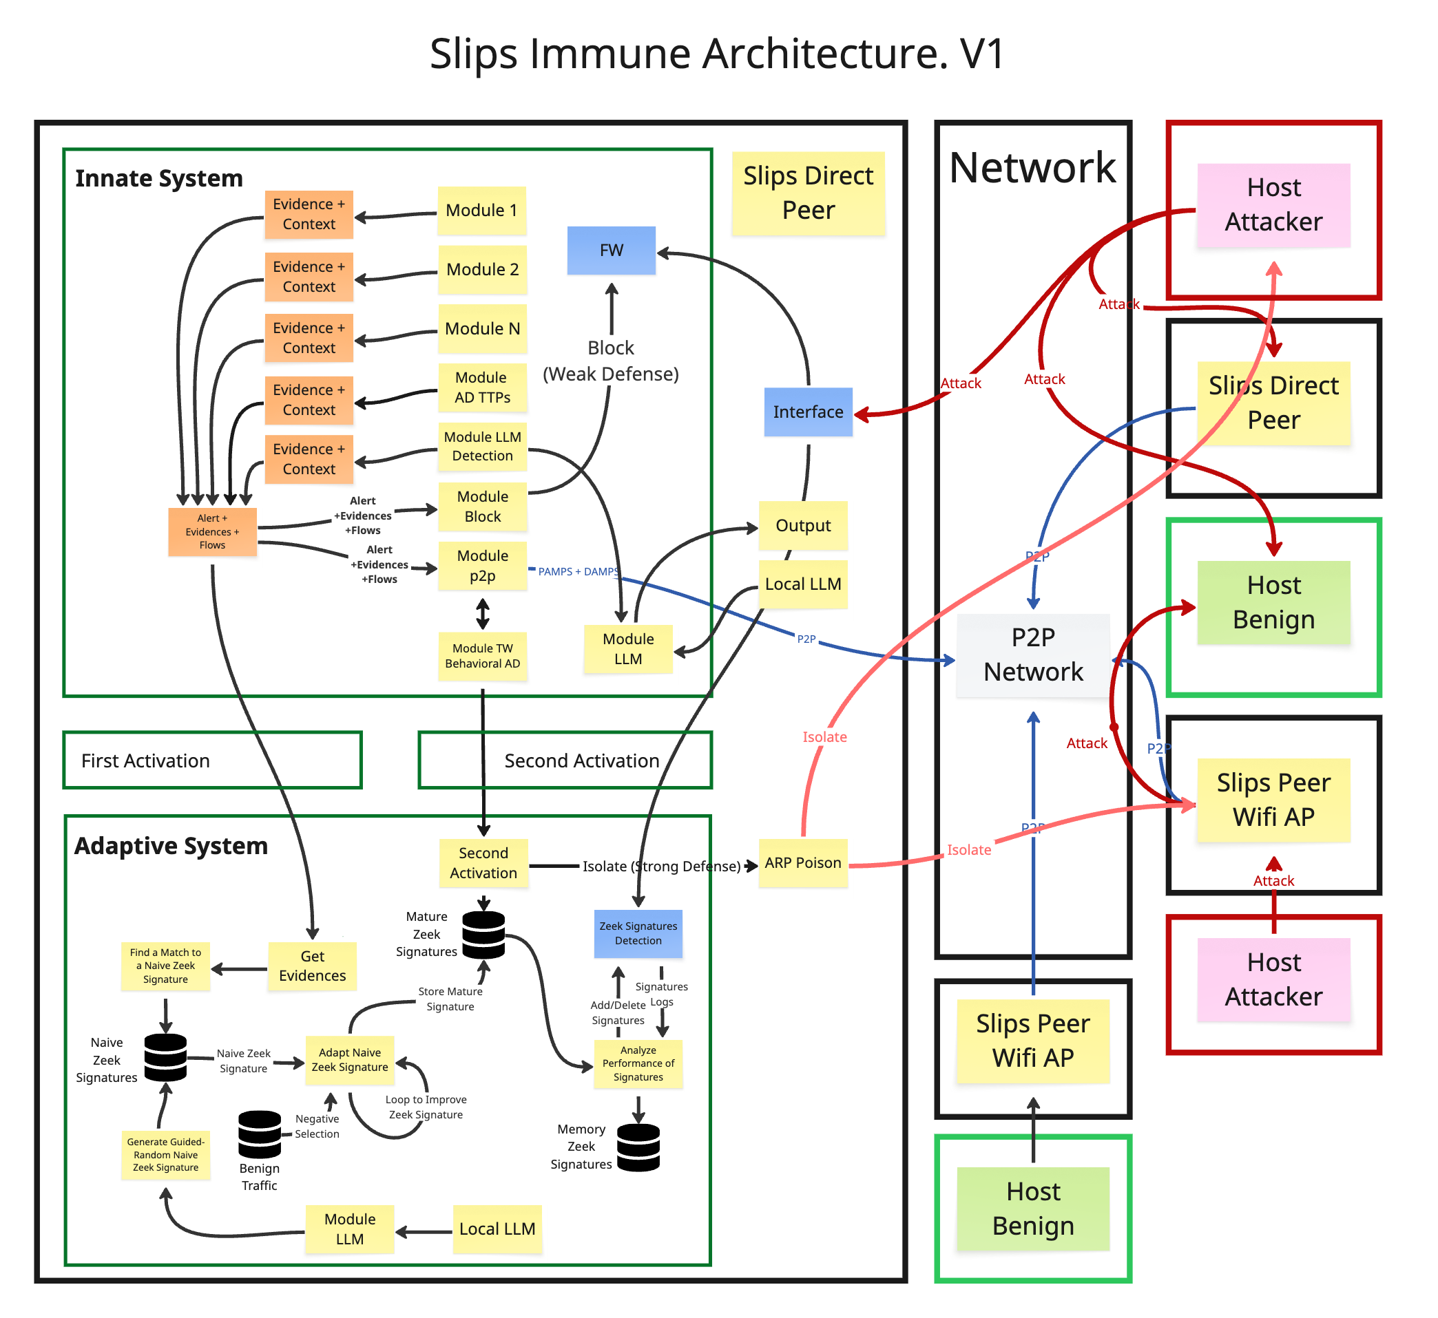
How SLIPS starts transferring these principles
Many modules already act as distributed sensors
Evidence is pushed into a shared pipeline
Alerts are based on accumulated evidence, not one event alone
The current research branch adds more explicit immune-inspired structure

Slide 17
Current branch: immune-signature-generation
1. Evidence signals
Each evidence item now carries an evidence_signal
Current signals:
  PAMP for attack-pattern-like evidence
  DAMP for damage or harm-related evidence
This makes stronger multi-signal reasoning possible
2. Shared LLM service
One shared module provides controlled access to local or remote LLM backends
Other modules request generation through Redis channels

Slide 18
Current branch: safer detector generation
RegexGenerator module
Generates candidate signatures one at a time with an LLM
Validates syntax and rejects dangerous regexes
Tests against a benign corpus
Stores accepted patterns in SQLite for reuse
Why this is immune-like
guided random generation
selection and rejection
memory of accepted detectors

Slide 19
Why this should interest AI people
Multi-agent systems need distributed sensing
LLM applications need gating before action
Safety requires proportional escalation
Memory should improve future decisions, not just store logs
Good autonomy depends as much on shutdown as on activation

Slide 20
Takeaways
Nature-inspired research is useful when it transfers principles, not slogans
The immune system offers a strong model for decision-making under uncertainty
Cybersecurity has often copied the wrong layer of the analogy
SLIPS shows one path from principle to implementation
Final message
If you build AI systems that must decide and act safely, immunology is worth studying.

Slide 21
Questions
One question to leave with
What would change in our AI systems if we designed them more like regulated immune systems and less like isolated predictors?

